Slide 1

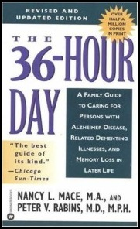
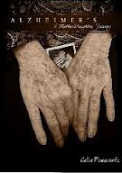
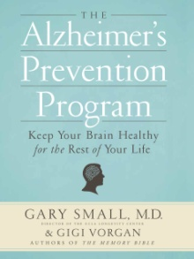

Booklovers List: Alzheimer’s Caregiving
The 36-Hour Day – A Family Guide to Caring for People with Alzheimer’s,
Other Dementias and Memory Loss in Later Life
Nancy Mace and Peter Rabins
John Hopkins University Press (2006)
An essential guide on what to expect when caring for someone with Alzheimer’s.
Alzheimer’s – A Mother-Daughter Journey
Celia Pomerantz
CreateSpace Publishing (2011)
A beautiful memoir of a daughter learning to find happiness in her mother’s
dementia diagnosis – especially through the power of music and dance.
Alzheimer’s Prevention Program
Dr. Gary Small with Gigi Vorgan
Workman Publishing (2011)
Foremost brain expert at the UCLA Longevity Center tells us what we can do now to help prevent the risk factors of Alzheimer’s and dementia – healthy tips on nutrition, exercise, relaxation to combat stress, etc.
Coach Broyles’ Playbook for Alzheimer’s Caregivers
Frank Broyles
University of Arkansas Press (2006)
Written by the Athletic Director for the University of Arkansas Razorbacks – a
spouse and family guide to dealing with Alzheimer’s in your family.
For more Caregiving Club Booklovers Lists
Visit: www.caregivingclub/booklovers
Copyright ©2013 Caregiving Club, Inc.
Page 1 of 2

Slide 2
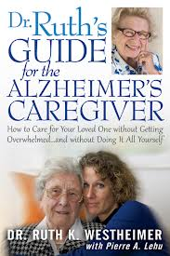


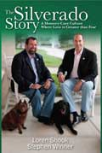

Booklovers List: Alzheimer’s Caregiving
Dr. Ruth’s Guide for the Alzheimer’s Caregiver
By Ruth K. Westheimer with Pierre A. Lehu
Quill Driver Books (2012)
A thorough look at coping with caregiving for those with dementia from America’s #1 name in relationship therapy.
I Still Do – Loving and Living with Alzheimer’s
Judith Fox
powerhouse Books (2009)
A beautiful photo book which also captures the emotional spectrum in images and words about spousal caregiving for those with dementia.
The Shriver Report – A Woman’s Nation Takes on Alzheimer’s
By Maria Shriver, Alzheimer’s Association
Free Press (2010)
This comprehensive book sheds light on the growing epidemic of Alzheimer’s in America including research, resources, personal stories, workplace, gender, diversity and the policy issues facing our nation.
The Silverado Story – A Memory Care Culture Where Love is
Greater Than Fear
By Loren Shook and Steve Winner
AJC Press (2010)
Written by two men who were Alzheimer’s caregivers and now run one of the most innovative memory care communities and services in America.
Still Alice
Lisa Genova
Gallery Books (2009)
The story of a Harvard professor’s early on-set Alzheimer’s diagnosis at age 50. You’ll never look at Alzheimer’s disease the same way again.
For more Caregiving Club Booklovers Lists
Visit: www.caregivingclub/booklovers
Copyright ©2013 Caregiving Club, Inc.
Page 2 of 2

